Slide 1
State DOT Resilience Improvement Plans
How each plan defines resilience and scores risk, with original-source screenshots
Source set: 20 publicly downloaded PDF plans in C:\Users\xings\Desktop\dot rip

Slide 2
Reading Guide
Each state page pairs an interpretation with the exact source excerpt used for that interpretation.
Definition
What the DOT/FHWA text says resilience means: usually ability to anticipate, prepare, withstand, respond, adapt, and recover.
Risk scoring
How the plan turns hazards into priorities: matrix, index, score/rating, or qualitative risk-based vulnerability assessment.
Source evidence
Screenshots are cropped directly from the downloaded PDF. Footer lists filename, page number, and URL.

Slide 3
Cross-State Summary
Rows 1-10; concise interpretation from located source excerpts.
CA
California
Divisions of Maintenance, Design, and Planning in leading the Department’s integration of climate adaptation and resilience work in the State Highway Operation and Protection (SHOPP) Pr
score/rating / ??????: ?????? consequence/severity/?????, sensitivity/???, vulnerability/????
CO
Colorado
The State of Colorado defines resilience as “the ability of communities to rebound, positively adapt to, or thrive amidst changing conditions or challenges—including human-caused and na
risk-based assessment / ??????: ?????? likelihood/?????, probability/??, consequence/severity/?????, criticality/????
CT
Connecticut
Resilience The ability to anticipate, prepare for, and adapt to changing conditions and
score/rating / ??????: ?????? exposure/???, sensitivity/???, adaptive capacity/????, vulnerability/????
DE
Delaware
However, sound management of the assets on detour and emergency evacuation routes increases a highway system’s redundancy.” (FHWA, 2013) Resilience “Resilience or resiliency is the abil
risk-based assessment / ??????: ?????? probability/??, consequence/severity/?????, criticality/????
FL
Florida
1 RESILIENCE IMPROVEMENT PLAN COMMUNITY ENGAGEMENT PLAN FOR FDOT OPP RESILIENCE ACTIVITIES This Community Engagement Plan (CEP) describes community engagement activities to be conducted
?????????????????????/????????????????
IA
Iowa
The Iowa DOT defines resiliency as the ability to anticipate, prepare for, and adapt to changing conditions and withstand, respond to, and quickly recover from disruptions.
risk-based assessment / ??????: ?????? likelihood/?????, probability/??, consequence/severity/?????, vulnerability/????
KY
Kentucky
Transportation resilience, defined by the Federal Highway Administration (FHWA) as the ability to anticipate, prepare for, and adapt to changing conditions and withstand, respond to, an
score/rating / ??????: ?????? exposure/???, sensitivity/???, adaptive capacity/????, criticality/???, vulnerability/????
MD
Maryland
• Resilience Improvements: Improve the ability of existing surface transportation infrastructure to withstand extreme weather events and other natural hazards to support rapid recovery.
score/rating / ??????: ?????? likelihood/?????, probability/???
MI
Michigan
MDOT analyzed the risk associated with riverine/coastal flooding, stormwater flooding, coastal erosion, and extreme heat on transportation assets across the state and identified initiat
risk-based assessment / ??????: ?????? likelihood/?????, consequence/severity/?????, exposure/???, sensitivity/???, criticality/???, vulnerability/????
MN
Minnesota
APRIL 2024 RESILIENCE IMPROVEMENT PLAN 2024
score/rating / ??????: ?????? likelihood/?????, consequence/severity/?????, vulnerability/????

Slide 4
Cross-State Summary
Rows 11-20; concise interpretation from located source excerpts.
MS
Mississippi
• Prepare for anticipated natural hazards • Adapt to changing conditions • Withstand and recover rapidly from disruptions
score/rating / ??????: ?????? exposure/???, sensitivity/???, adaptive capacity/????, criticality/???, vulnerability/????
NC
North Carolina
As defined by the NCDOT Resilience Policy, resiliency is “the ability to anticipate, prepare for, and adapt to changing conditions and withstand, respond to, and recover rapidly from di
score/rating / ??????: ?????? likelihood/?????, probability/??, exposure/???, sensitivity/???, vulnerability/????
NM
New Mexico
N M D O T R E S I L I E N C E I M P R O V E M E N T P L A N New Mexico Department of Transportation Resilience Improvement Plan March 2024 Approved by FHWA July 26, 2024
score/rating / ??????: ?????? likelihood/?????, probability/??, consequence/severity/?????, exposure/???, sensitivity/???, criticality/???, vulnerability/????
OH
Ohio
A safe transportation system is one that can withstand extreme weather events and natural disasters.
risk-based assessment / ??????: ?????? vulnerability/????
OR
Oregon
RESILIENCE – The ability to anticipate, prepare for, and adapt to changing conditions and withstand, respond to, and recover rapidly from disruptions.
score/rating / ??????: ?????? consequence/severity/?????, exposure/????
RI
Rhode Island
Resilience is defined by RIDOT as the ability of the Rhode Island transportation system to anticipate, prepare for, and adapt to changing conditions; and withstand, respond to, and reco
risk-based assessment / ??????: ?????? exposure/???, sensitivity/???, adaptive capacity/????, vulnerability/????
TX
Texas
Resilience is the ability to support and maintain a multimodal transportation system that can safely move people, goods, and services during adverse conditions, and to be able to antici
risk-based assessment / ??????: ?????? exposure/???, sensitivity/???, vulnerability/????
UT
Utah
FHWA defines resilience as the ability to anticipate, prepare for, or adapt to conditions or withstand, respond to, or recover rapidly from disruptions.
score/rating / ??????: ?????? exposure/???, criticality/????
VA
Virginia
TABLE OF CONTENTS Resilience Plan Roadmap towards a resilient transportation system RESILIENCE PLAN November 2022 Version 1.0
risk-based assessment / ??????: ?????? exposure/???, sensitivity/???, adaptive capacity/????, criticality/???, vulnerability/????
VT
Vermont
Resilience Improvement Plan Draft Process Underway February 6, 2023
?????????????????????/????????????????

Slide 5
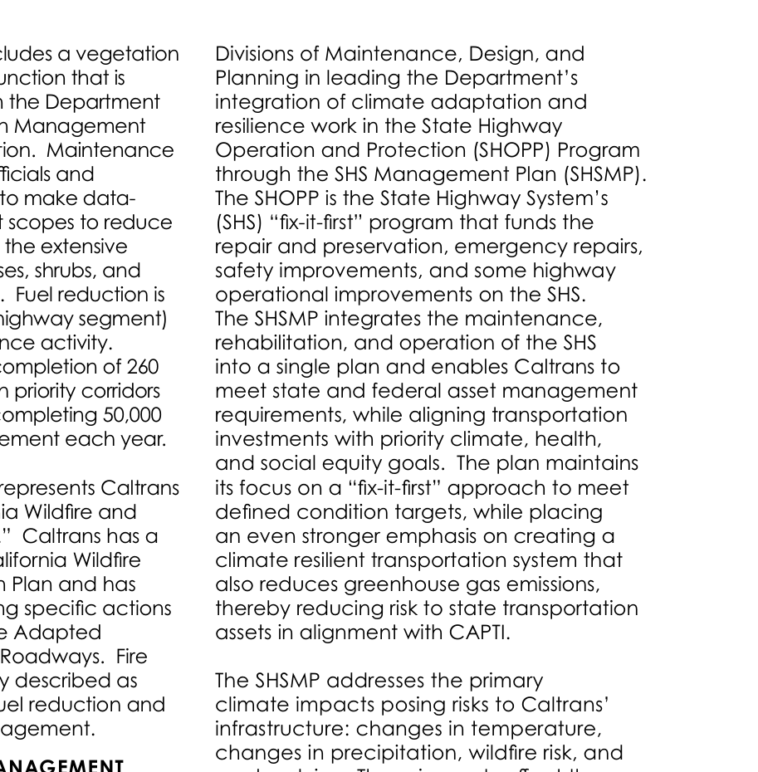
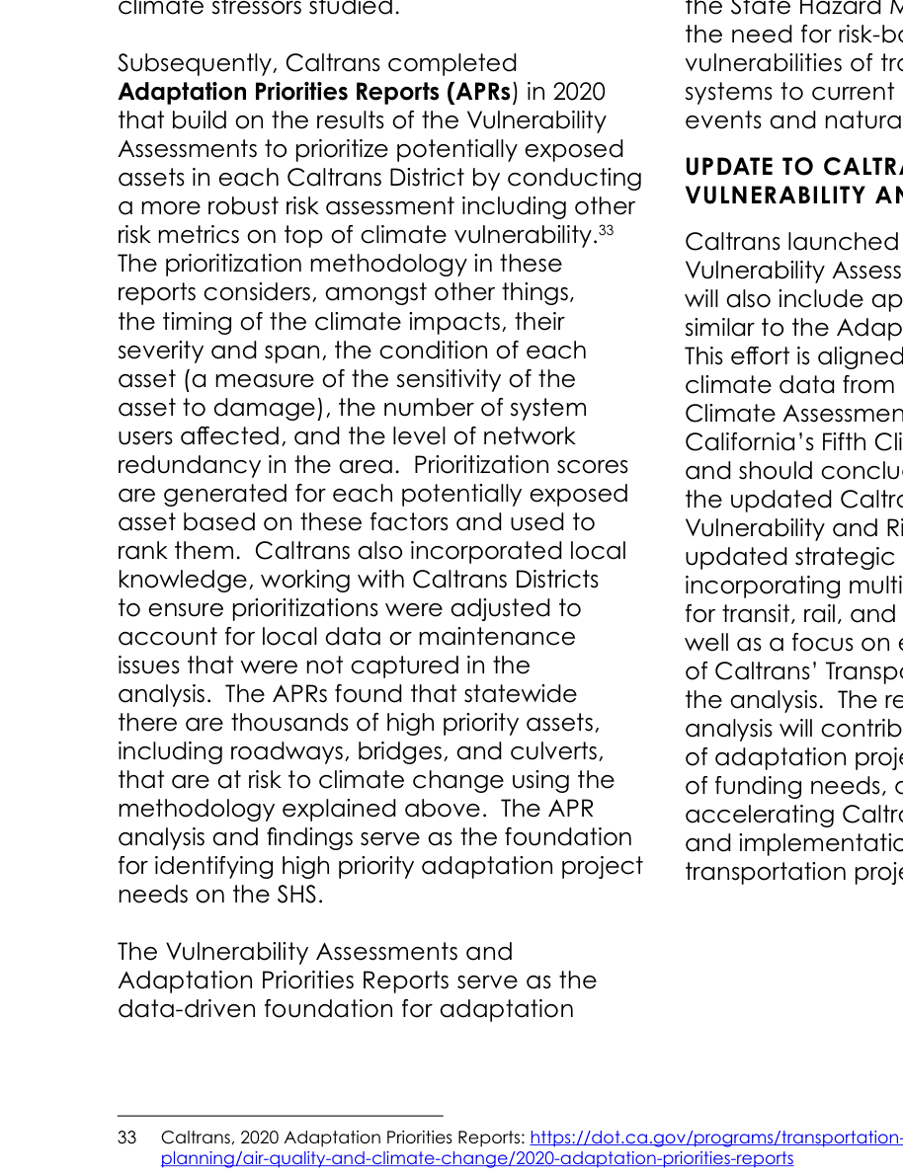
California / Caltrans: definition and risk scoring
1/20 | CA_Caltrans_SCRIPT_RIP_2023_Amendment1.pdf
Original excerpt: definition
Resilience definition - summary
Divisions of Maintenance, Design, and Planning in leading the Department’s integration of climate adaptation and resilience work in the State Highway Operation and Protection (SHOPP) Program through the SHS Management Plan (SHSMP).
Source page: p. 27
Original excerpt: risk scoring / assessment
Risk scoring - summary
score/rating / ??????: ?????? consequence/severity/?????, sensitivity/???, vulnerability/????
Source page: p. 29
Source: CA_Caltrans_SCRIPT_RIP_2023_Amendment1.pdf; definition p.27, risk p.29; URL: https://dot.ca.gov/-/media/dot-media/programs/transportation-planning/documents/office-of-smart-mobility-and-climate-change/2023-script-amendment-1-with-letters-a11y.pdf

Slide 6
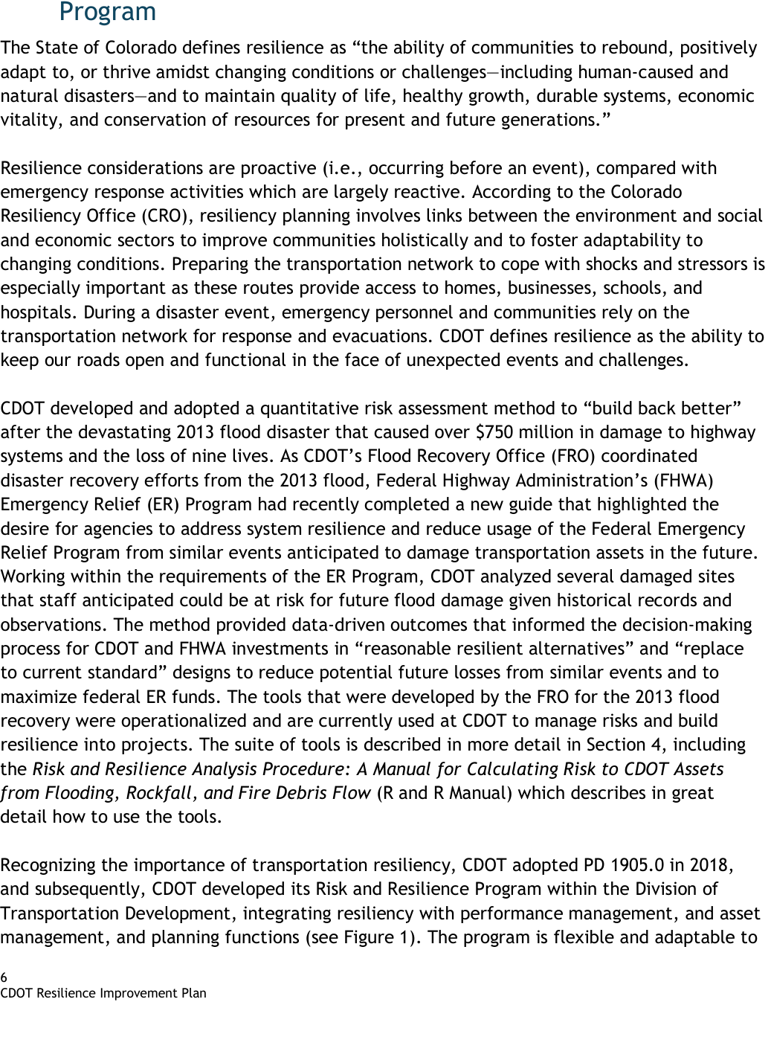
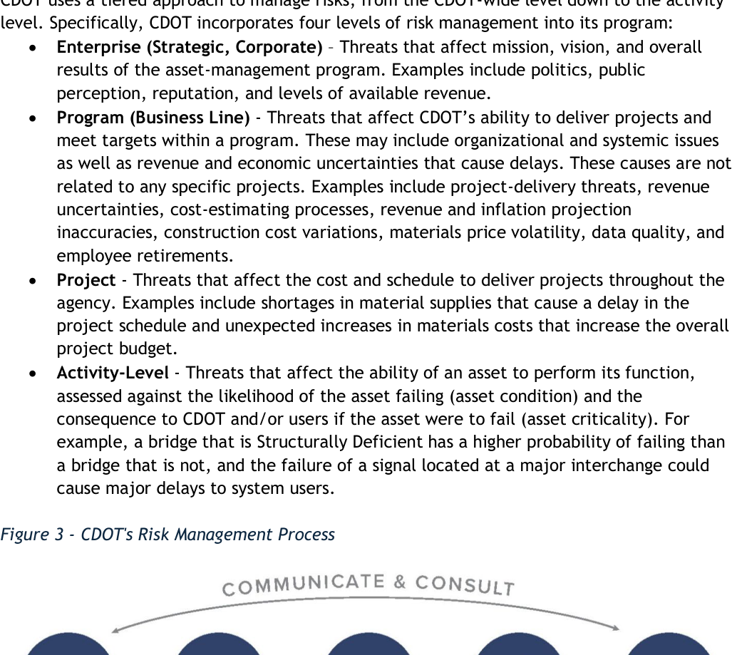
Colorado / CDOT: definition and risk scoring
2/20 | CO_CDOT_Resilience_Improvement_Plan.pdf
Original excerpt: definition
Resilience definition - summary
The State of Colorado defines resilience as “the ability of communities to rebound, positively adapt to, or thrive amidst changing conditions or challenges—including human-caused and natural disasters—and to maintain quality of life, healthy growth, durable systems, economic vitality, and conservation of resources for present and future g
Source page: p. 6
Original excerpt: risk scoring / assessment
Risk scoring - summary
risk-based assessment / ??????: ?????? likelihood/?????, probability/??, consequence/severity/?????, criticality/????
Source page: p. 14
Source: CO_CDOT_Resilience_Improvement_Plan.pdf; definition p.6, risk p.14; URL: https://www.tam-portal.com/wp-content/uploads/sites/12/2025/07/cdot-resilience-improvement-plan-final-02-10-2025.pdf

Slide 7
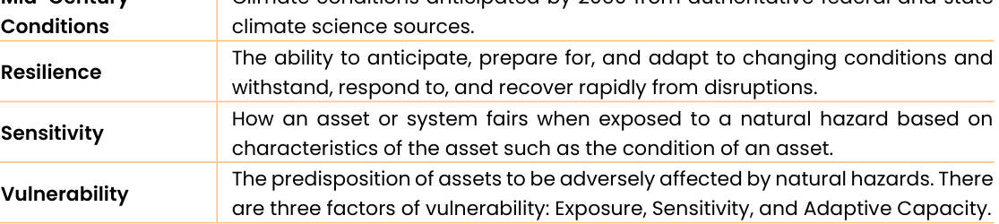
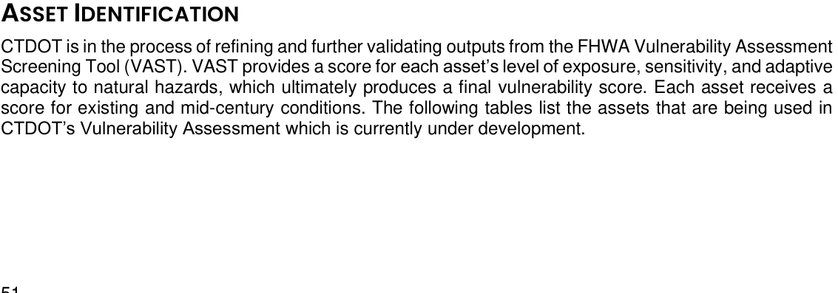
Connecticut / CTDOT: definition and risk scoring
3/20 | CT_CTDOT_Resilience_Improvement_Plan.pdf
Original excerpt: definition
Resilience definition - summary
Resilience The ability to anticipate, prepare for, and adapt to changing conditions and
Source page: p. 6
Original excerpt: risk scoring / assessment
Risk scoring - summary
score/rating / ??????: ?????? exposure/???, sensitivity/???, adaptive capacity/????, vulnerability/????
Source page: p. 59
Source: CT_CTDOT_Resilience_Improvement_Plan.pdf; definition p.6, risk p.59; URL: https://portal.ct.gov/dot/-/media/dot/programs/rip/ctdot-resilience-improvement-plan.pdf

Slide 8
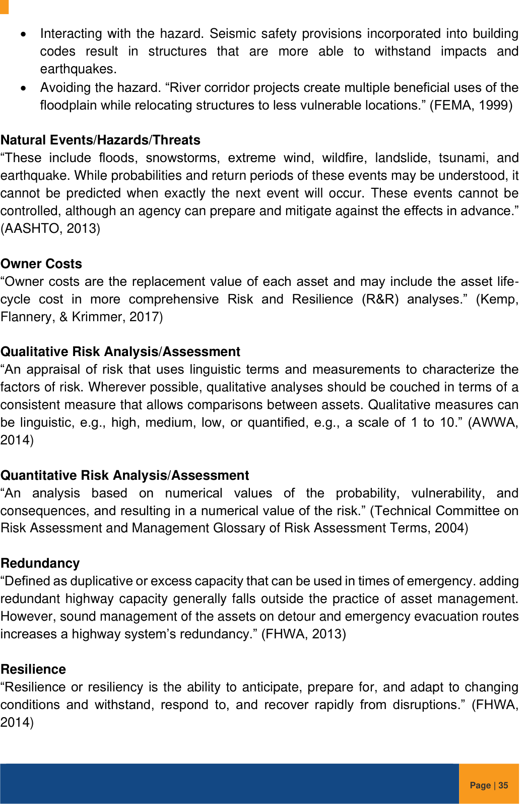
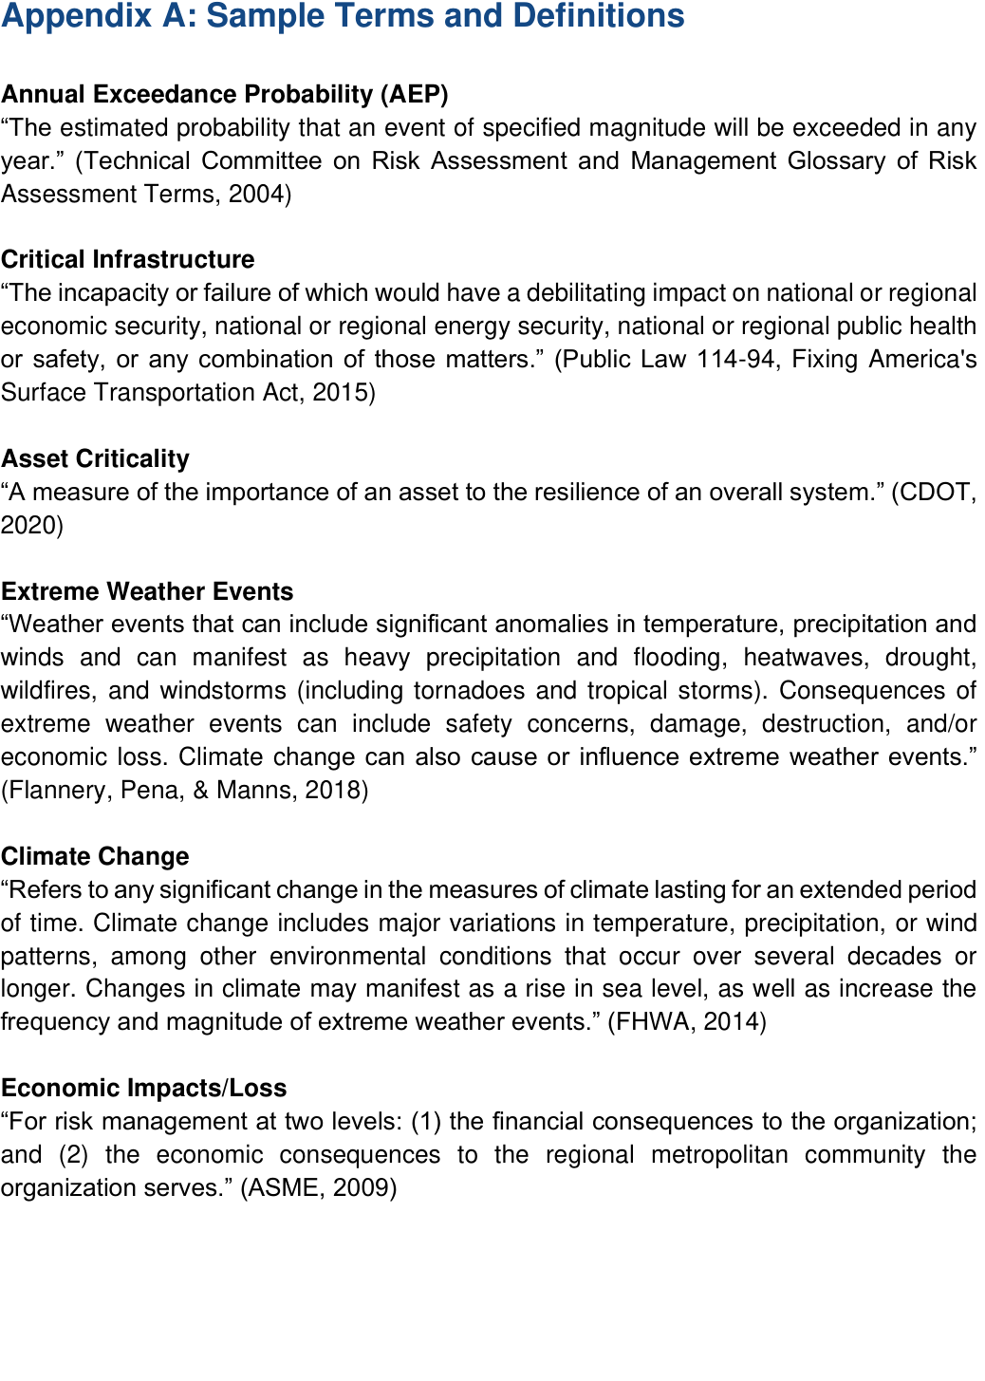
Delaware / DelDOT: definition and risk scoring
4/20 | DE_DelDOT_DRIP_FHWA_Approved_2023.pdf
Original excerpt: definition
Resilience definition - summary
However, sound management of the assets on detour and emergency evacuation routes increases a highway system’s redundancy.” (FHWA, 2013) Resilience “Resilience or resiliency is the ability to anticipate, prepare for, and adapt to changing conditions and withstand, respond to, and recover rapidly from disruptions.” (FHWA, 2014)
Source page: p. 40
Original excerpt: risk scoring / assessment
Risk scoring - summary
risk-based assessment / ??????: ?????? probability/??, consequence/severity/?????, criticality/????
Source page: p. 38
Source: DE_DelDOT_DRIP_FHWA_Approved_2023.pdf; definition p.40, risk p.38; URL: https://www.erm-portal.com/wp-content/uploads/sites/15/wpforms/7075-e1233af55e4247e91b2324b29a729bf8/DelDOT-DRIP-FHWA-Approved-09.07.23-a120b9904b5093d01726203eead2d3af.pdf

Slide 9
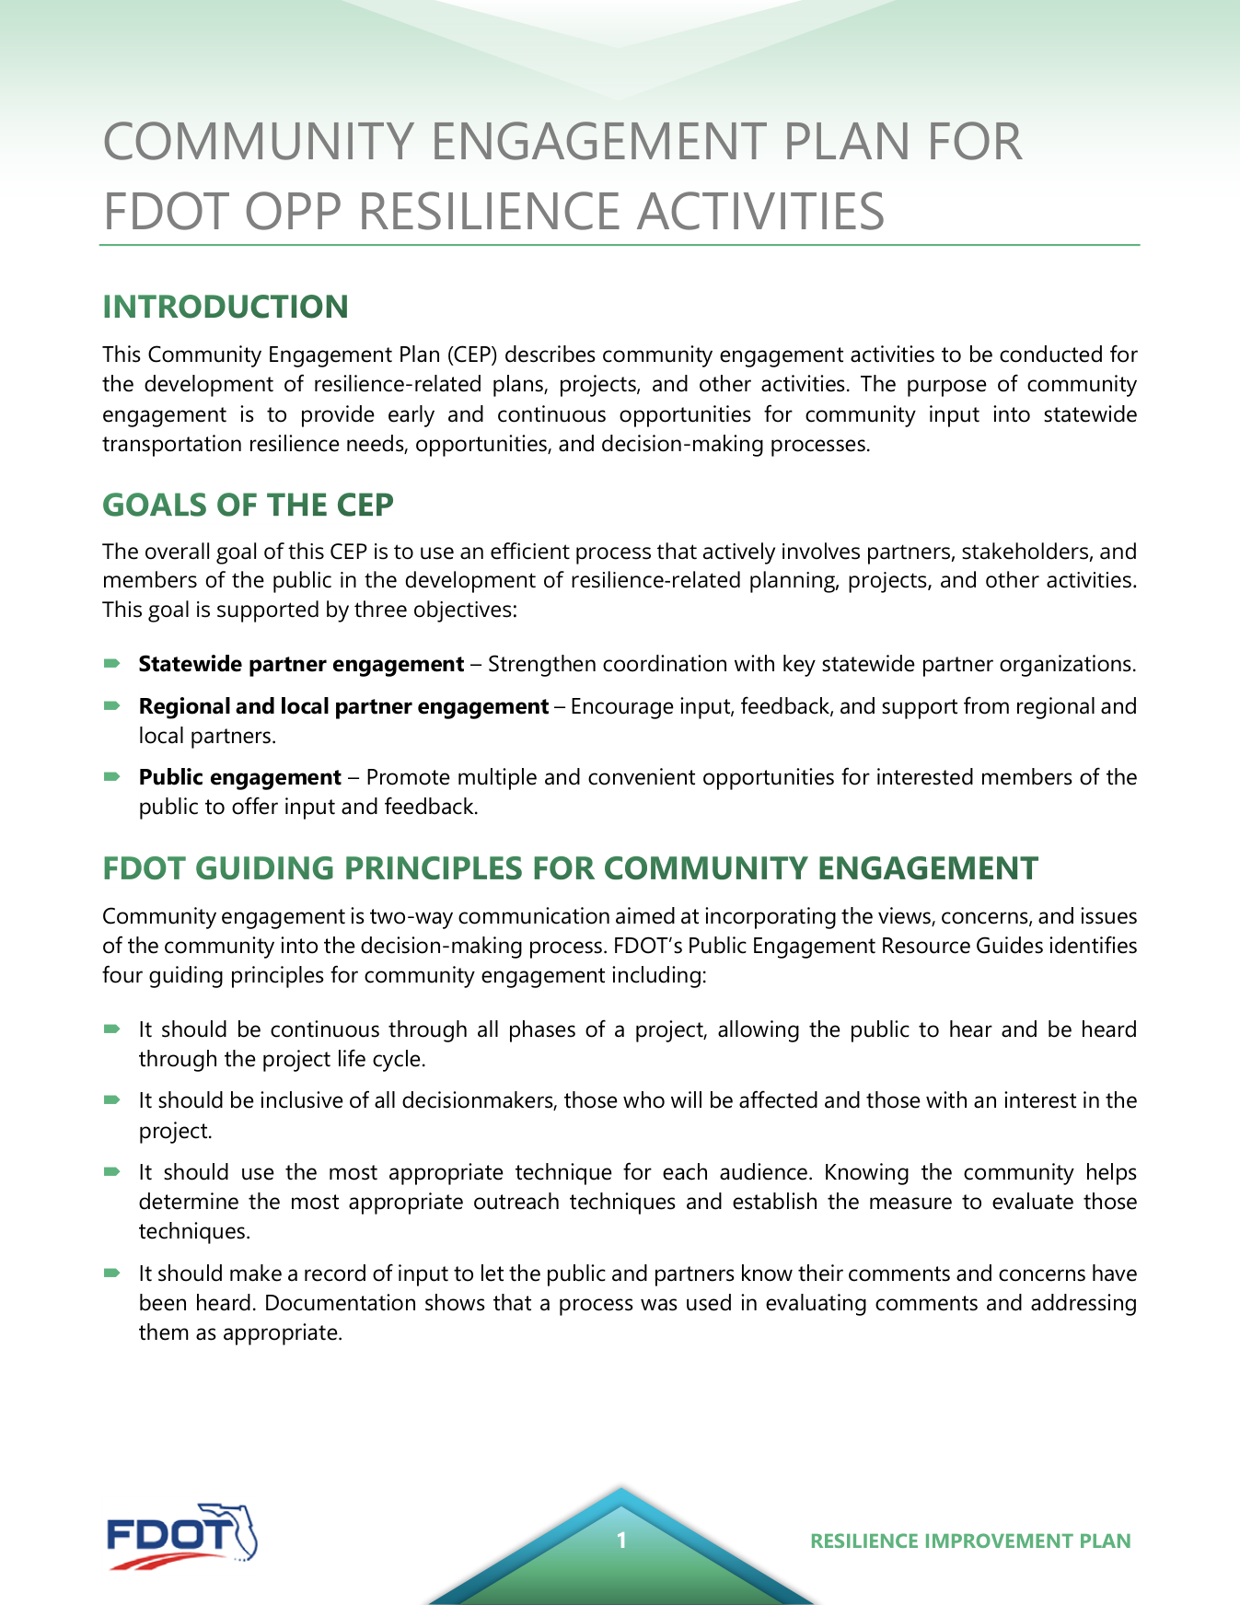
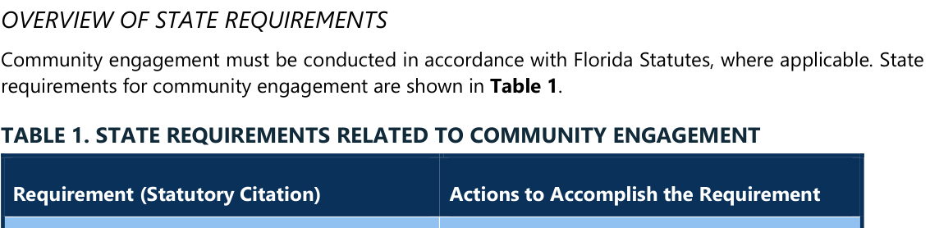
Florida / FDOT: definition and risk scoring
5/20 | FL_FDOT_RIP_CEP_Final.pdf
Original excerpt: definition
Resilience definition - summary
1 RESILIENCE IMPROVEMENT PLAN COMMUNITY ENGAGEMENT PLAN FOR FDOT OPP RESILIENCE ACTIVITIES This Community Engagement Plan (CEP) describes community engagement activities to be conducted for the development of resilience-related plans, projects, and other activities.
Source page: p. 1
Original excerpt: risk scoring / assessment
Risk scoring - summary
?????????????????????/????????????????
Source page: p. 3
Source: FL_FDOT_RIP_CEP_Final.pdf; definition p.1, risk p.3; URL: https://fdotwww.blob.core.windows.net/sitefinity/docs/default-source/planning/resilience-(opp)/resilience-improvement-plan/rip_cep_final.pdf?sfvrsn=b8098df8_1

Slide 10
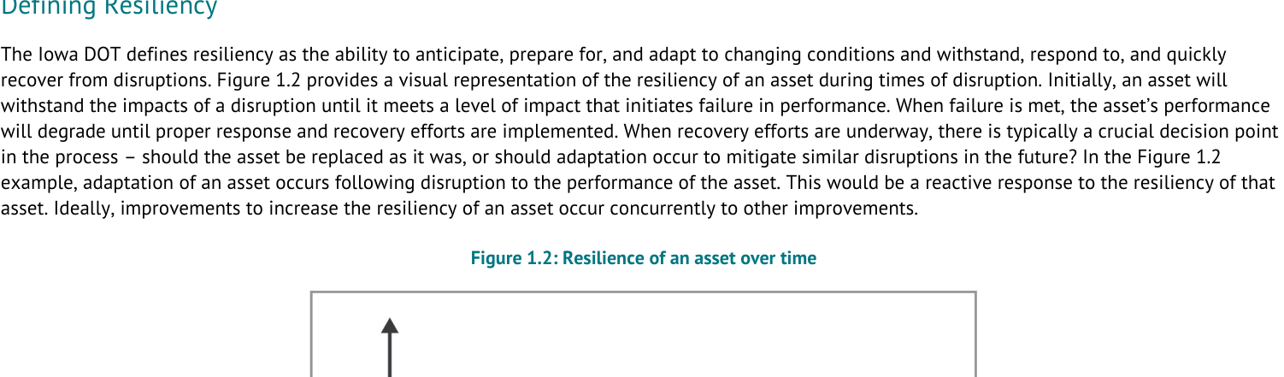
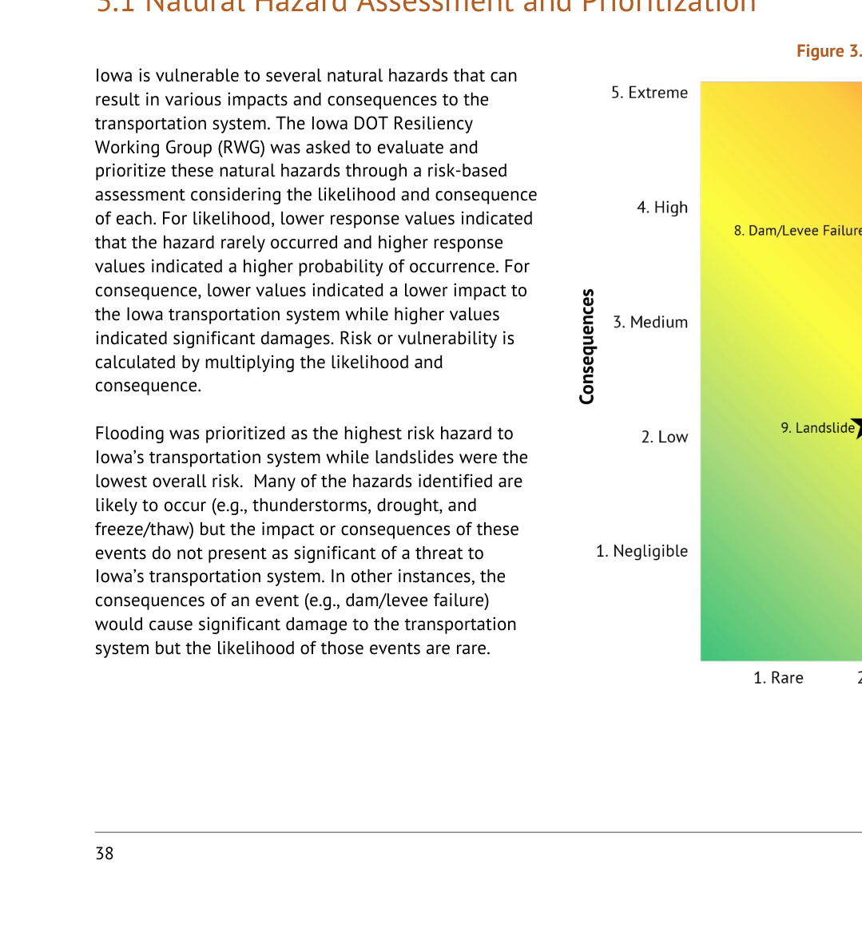
Iowa / Iowa DOT: definition and risk scoring
6/20 | IA_IowaDOT_2024_Resilience_Improvement_Plan.pdf
Original excerpt: definition
Resilience definition - summary
The Iowa DOT defines resiliency as the ability to anticipate, prepare for, and adapt to changing conditions and withstand, respond to, and quickly recover from disruptions.
Source page: p. 8
Original excerpt: risk scoring / assessment
Risk scoring - summary
risk-based assessment / ??????: ?????? likelihood/?????, probability/??, consequence/severity/?????, vulnerability/????
Source page: p. 38
Source: IA_IowaDOT_2024_Resilience_Improvement_Plan.pdf; definition p.8, risk p.38; URL: https://iowadot.gov/media/2596/download?inline=

Slide 11
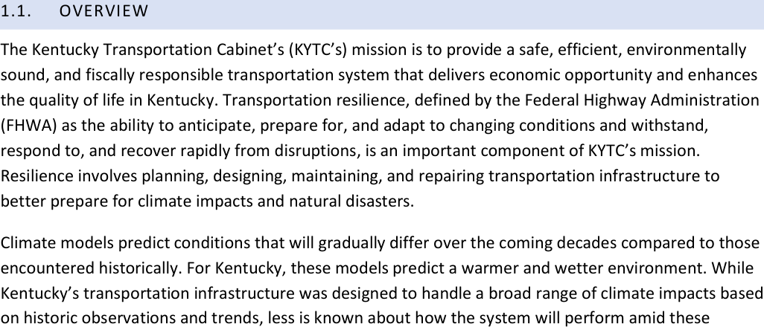
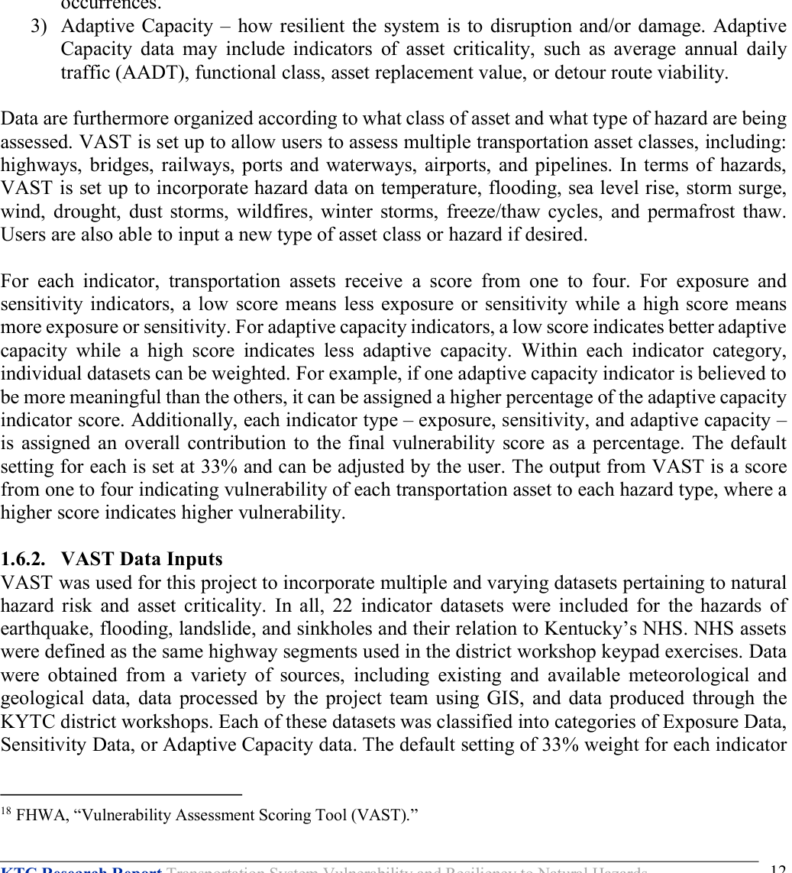
Kentucky / KYTC: definition and risk scoring
7/20 | KY_KYTC_Resiliency_Improvement_Plan_2023.pdf
Original excerpt: definition
Resilience definition - summary
Transportation resilience, defined by the Federal Highway Administration (FHWA) as the ability to anticipate, prepare for, and adapt to changing conditions and withstand, respond to, and recover rapidly from disruptions, is an important component of KYTC’s mission.
Source page: p. 3
Original excerpt: risk scoring / assessment
Risk scoring - summary
score/rating / ??????: ?????? exposure/???, sensitivity/???, adaptive capacity/????, criticality/???, vulnerability/????
Source page: p. 53
Source: KY_KYTC_Resiliency_Improvement_Plan_2023.pdf; definition p.3, risk p.53; URL: https://www.erm-portal.com/wp-content/uploads/sites/15/2024/08/KYTC-Resiliency-Improvement-Plan-202306-bfe355f2a24c9e7591e4146a5b7226e1.pdf

Slide 12
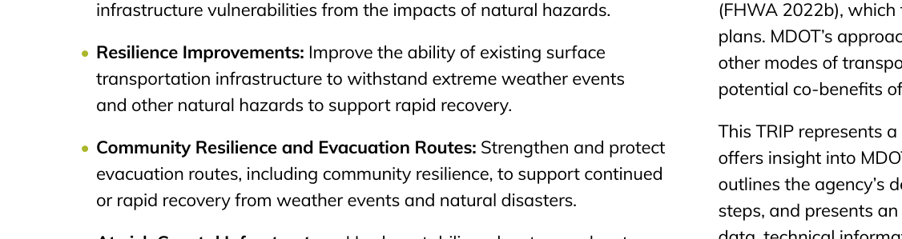
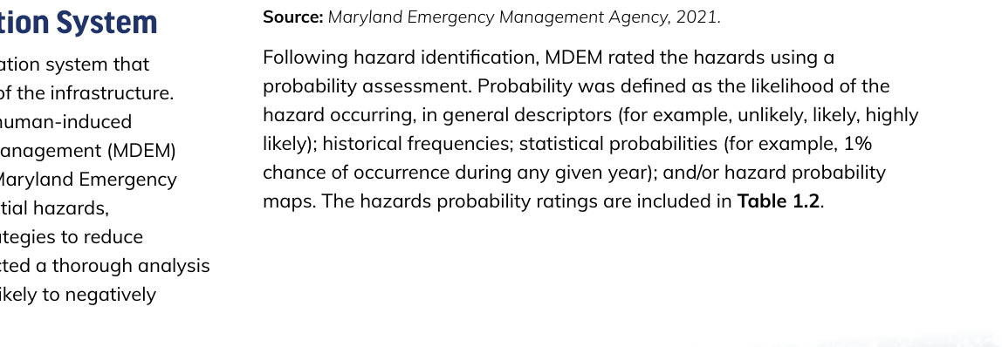
Maryland / MDOT: definition and risk scoring
8/20 | MD_MDOT_Transportation_Resilience_Improvement_Plan_2024.pdf
Original excerpt: definition
Resilience definition - summary
• Resilience Improvements: Improve the ability of existing surface transportation infrastructure to withstand extreme weather events and other natural hazards to support rapid recovery.
Source page: p. 4
Original excerpt: risk scoring / assessment
Risk scoring - summary
score/rating / ??????: ?????? likelihood/?????, probability/???
Source page: p. 11
Source: MD_MDOT_Transportation_Resilience_Improvement_Plan_2024.pdf; definition p.4, risk p.11; URL: https://www.mdot.maryland.gov/OPCP/MDOT_TRIP_Report_2024_Final.pdf

Slide 13
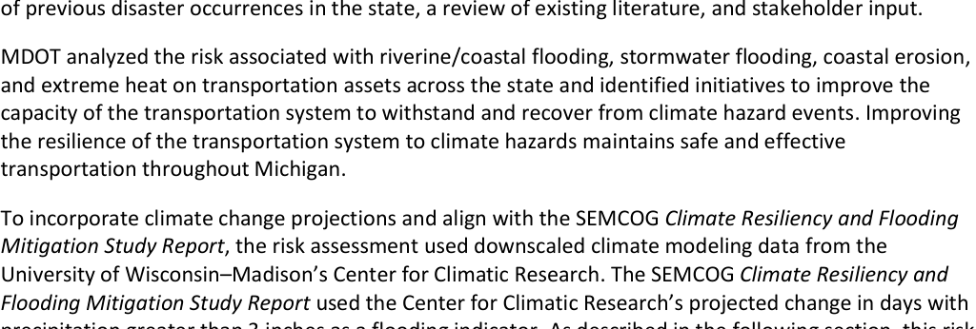
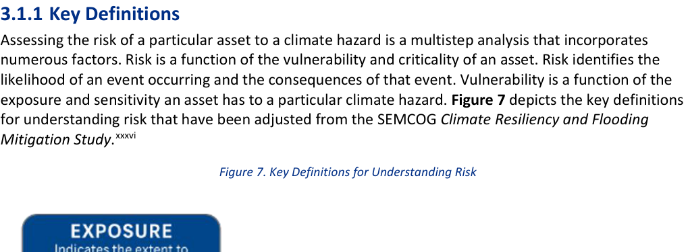
Michigan / MDOT: definition and risk scoring
9/20 | MI_MDOT_Resilience_Improvement_Plan_2024.pdf
Original excerpt: definition
Resilience definition - summary
MDOT analyzed the risk associated with riverine/coastal flooding, stormwater flooding, coastal erosion, and extreme heat on transportation assets across the state and identified initiatives to improve the capacity of the transportation system to withstand and recover from climate hazard events.
Source page: p. 16
Original excerpt: risk scoring / assessment
Risk scoring - summary
risk-based assessment / ??????: ?????? likelihood/?????, consequence/severity/?????, exposure/???, sensitivity/???, criticality/???, vulnerability/????
Source page: p. 16
Source: MI_MDOT_Resilience_Improvement_Plan_2024.pdf; definition p.16, risk p.16; URL: https://www.michigan.gov/mdot/-/media/Project/Websites/MDOT/Programs/Planning/Resilience-Improvement-Plan/Plan.pdf

Slide 14
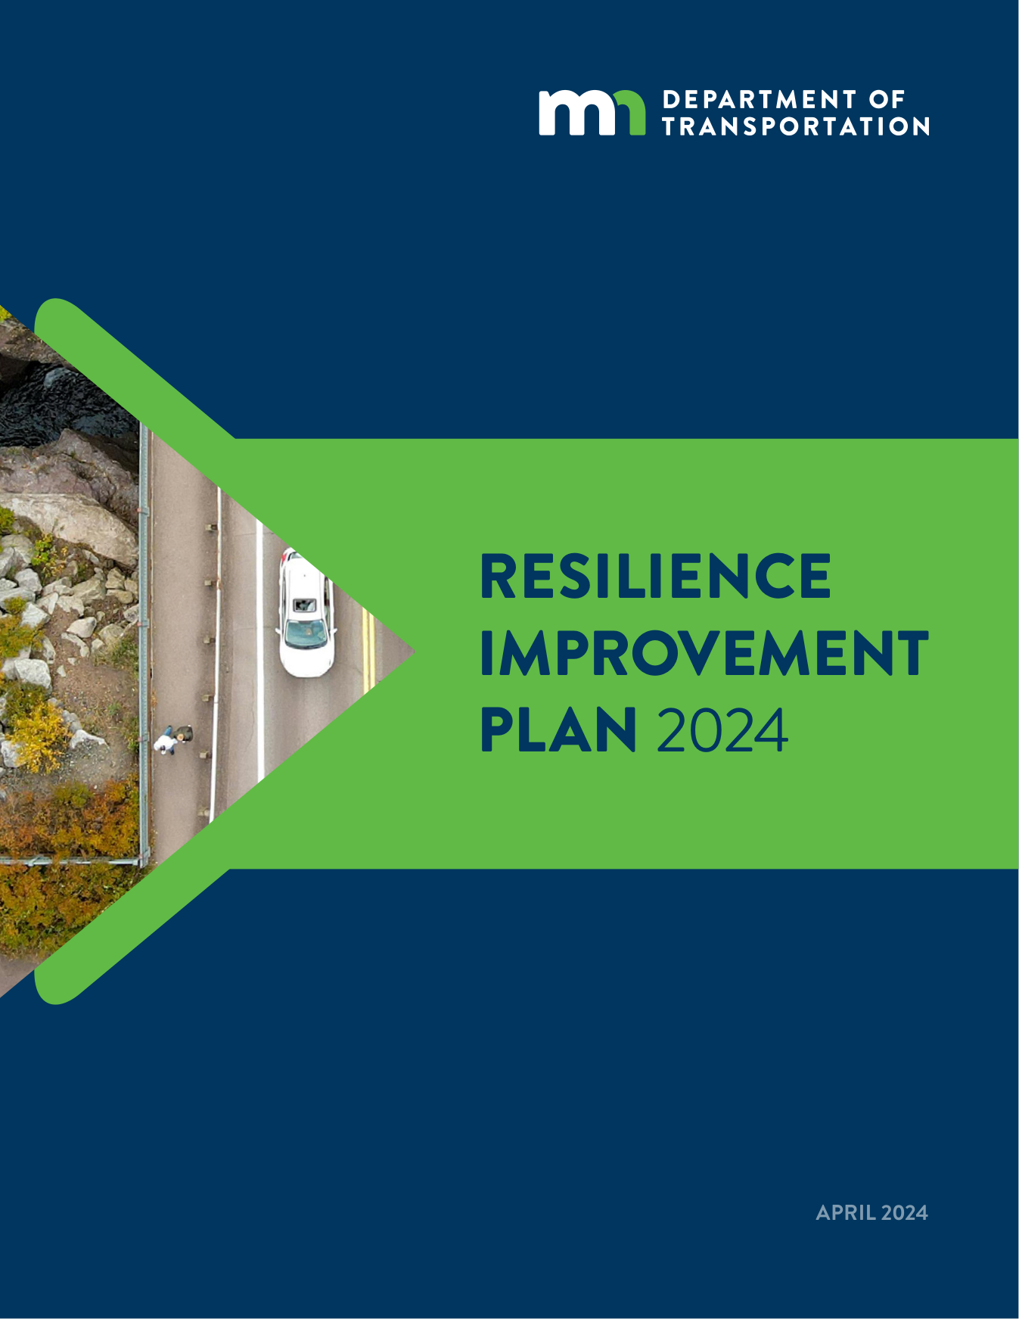
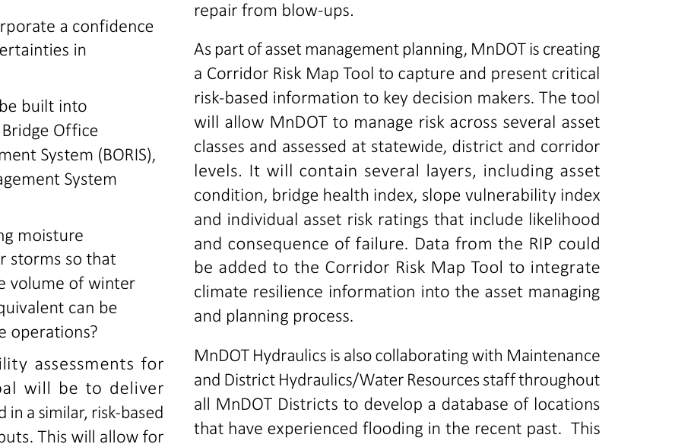
Minnesota / MnDOT: definition and risk scoring
10/20 | MN_MnDOT_Resilience_Improvement_Plan_2024.pdf
Original excerpt: definition
Resilience definition - summary
APRIL 2024 RESILIENCE IMPROVEMENT PLAN 2024
Source page: p. 1
Original excerpt: risk scoring / assessment
Risk scoring - summary
score/rating / ??????: ?????? likelihood/?????, consequence/severity/?????, vulnerability/????
Source page: p. 49
Source: MN_MnDOT_Resilience_Improvement_Plan_2024.pdf; definition p.1, risk p.49; URL: https://www.tam-portal.com/wp-content/uploads/sites/12/2025/07/2024-Resilience-Improvement-Plan-ADA-FINAL-38633998-v2.pdf

Slide 15
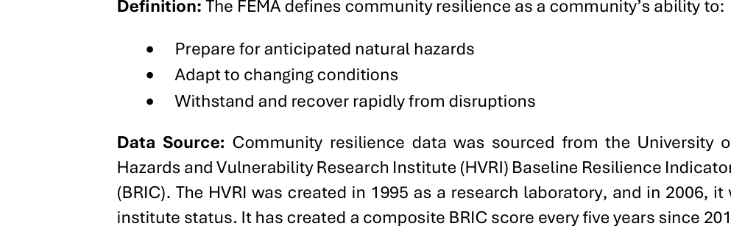
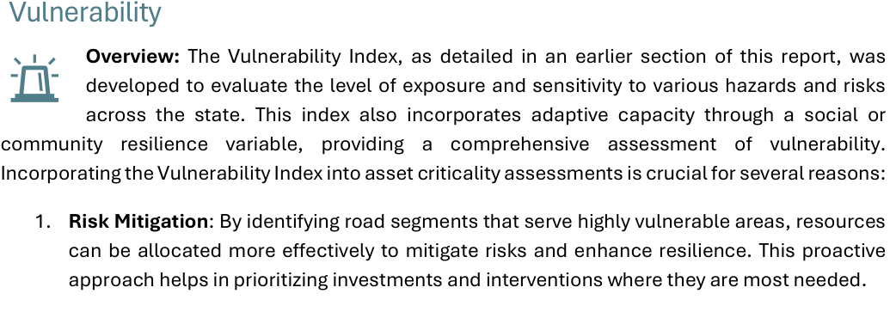
Mississippi / MDOT: definition and risk scoring
11/20 | MS_MDOT_Resilience_Improvement_Plan.pdf
Original excerpt: definition
Resilience definition - summary
• Prepare for anticipated natural hazards • Adapt to changing conditions • Withstand and recover rapidly from disruptions
Source page: p. 30
Original excerpt: risk scoring / assessment
Risk scoring - summary
score/rating / ??????: ?????? exposure/???, sensitivity/???, adaptive capacity/????, criticality/???, vulnerability/????
Source page: p. 87
Source: MS_MDOT_Resilience_Improvement_Plan.pdf; definition p.30, risk p.87; URL: https://mdot.ms.gov/documents/Planning/Resilience%20Planning/MDOT%20Resilience%20Improvement%20Plan.pdf

Slide 16
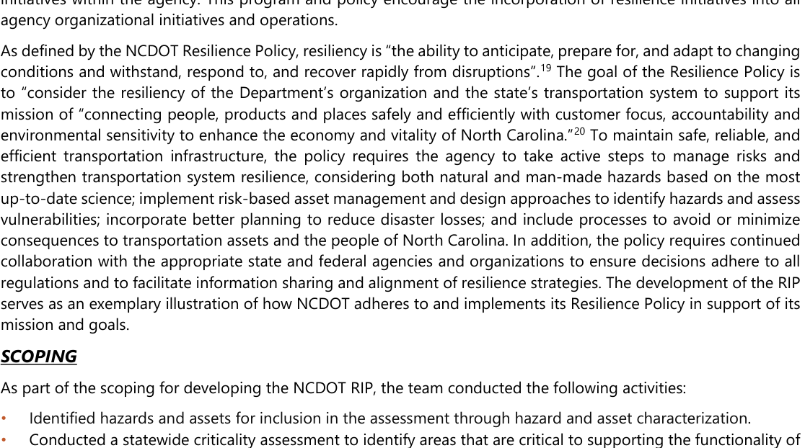
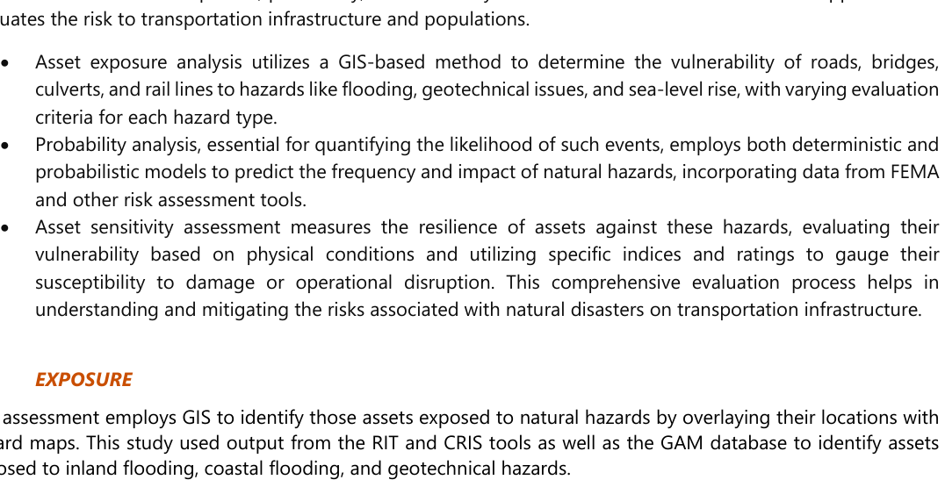
North Carolina / NCDOT: definition and risk scoring
12/20 | NC_NCDOT_Resilience_Strategy_Report.pdf
Original excerpt: definition
Resilience definition - summary
As defined by the NCDOT Resilience Policy, resiliency is “the ability to anticipate, prepare for, and adapt to changing conditions and withstand, respond to, and recover rapidly from disruptions”.19 The goal of the Resilience Policy is to “consider the resiliency of the Department’s organization and the state’s transportation system to su
Source page: p. 13
Original excerpt: risk scoring / assessment
Risk scoring - summary
score/rating / ??????: ?????? likelihood/?????, probability/??, exposure/???, sensitivity/???, vulnerability/????
Source page: p. 45
Source: NC_NCDOT_Resilience_Strategy_Report.pdf; definition p.13, risk p.45; URL: https://www.ncdot.gov/initiatives-policies/Transportation/transportation-resilience/Documents/resilience-plan.pdf

Slide 17
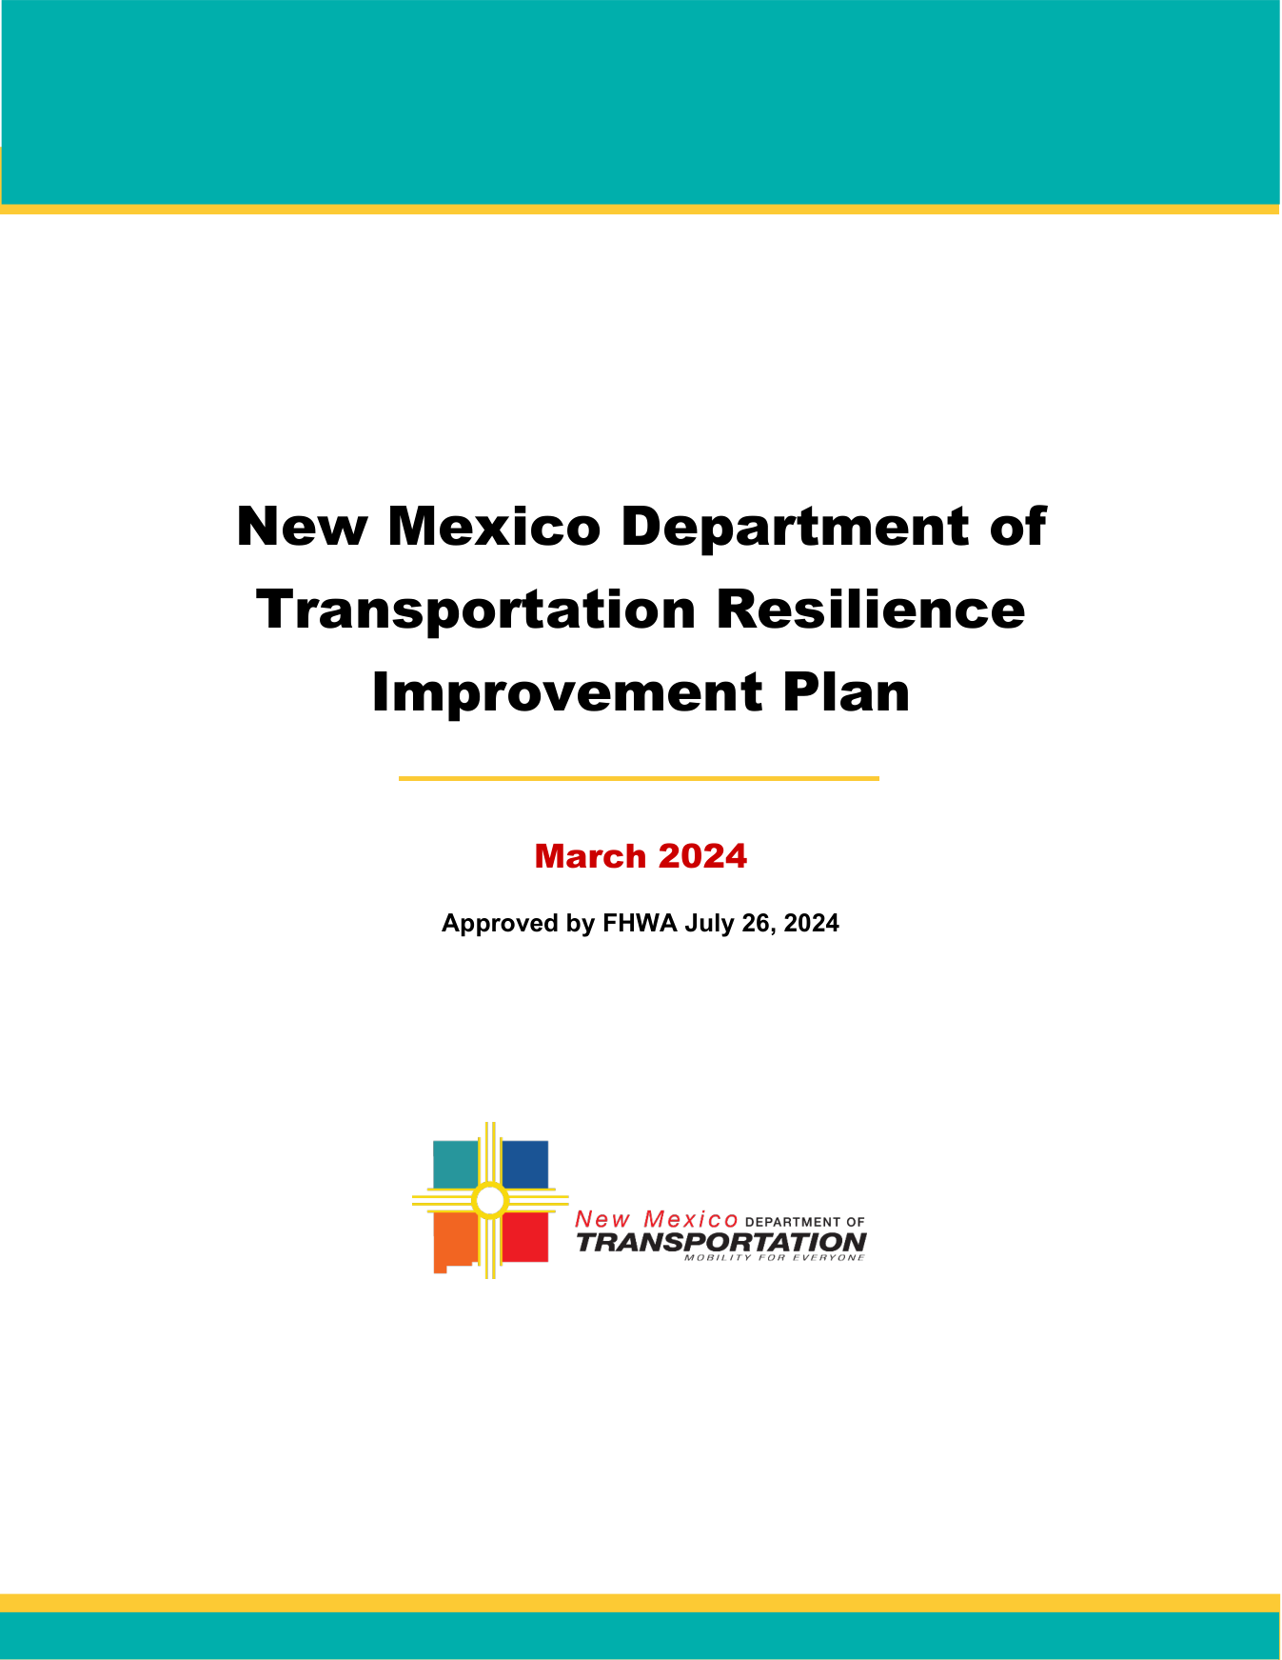
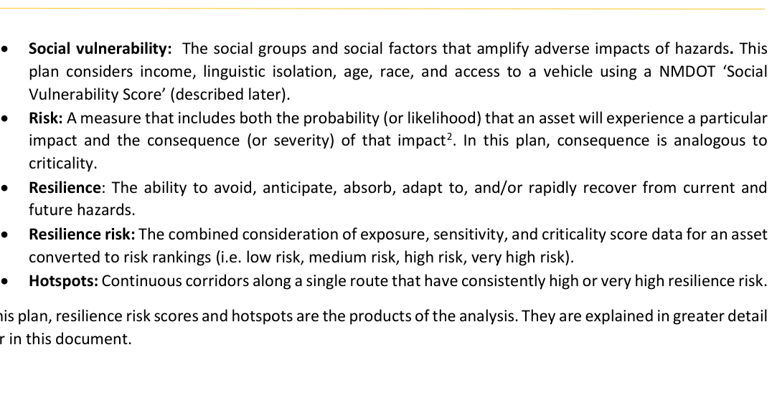
New Mexico / NMDOT: definition and risk scoring
13/20 | NM_NMDOT_Resilience_Improvement_Plan_2024.pdf
Original excerpt: definition
Resilience definition - summary
N M D O T R E S I L I E N C E I M P R O V E M E N T P L A N New Mexico Department of Transportation Resilience Improvement Plan March 2024 Approved by FHWA July 26, 2024
Source page: p. 1
Original excerpt: risk scoring / assessment
Risk scoring - summary
score/rating / ??????: ?????? likelihood/?????, probability/??, consequence/severity/?????, exposure/???, sensitivity/???, criticality/???, vulnerability/????
Source page: p. 9
Source: NM_NMDOT_Resilience_Improvement_Plan_2024.pdf; definition p.1, risk p.9; URL: https://www.erm-portal.com/wp-content/uploads/sites/15/2024/08/2024_0324_NMDOT-RIP_Final-3e0d72b101139cc6da2af69c7c26a4d5.pdf

Slide 18
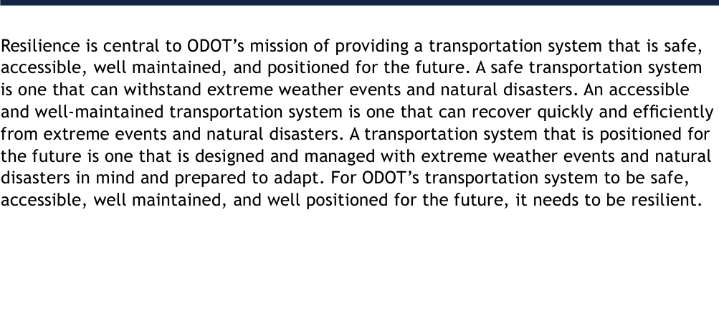
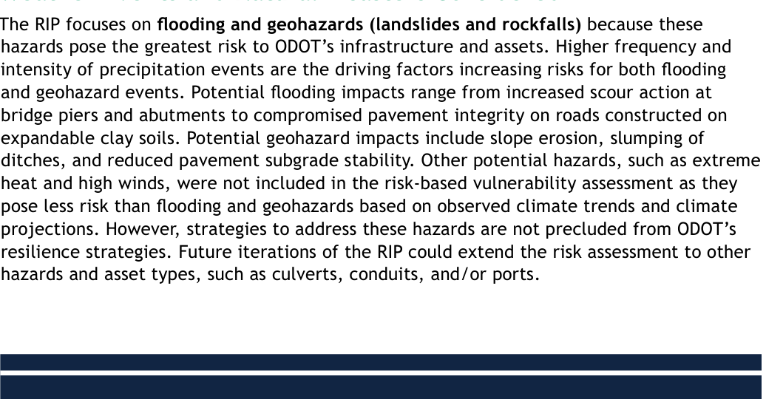
Ohio / ODOT: definition and risk scoring
14/20 | OH_ODOT_Resilience_Improvement_Plan.pdf
Original excerpt: definition
Resilience definition - summary
A safe transportation system is one that can withstand extreme weather events and natural disasters.
Source page: p. 5
Original excerpt: risk scoring / assessment
Risk scoring - summary
risk-based assessment / ??????: ?????? vulnerability/????
Source page: p. 10
Source: OH_ODOT_Resilience_Improvement_Plan.pdf; definition p.5, risk p.10; URL: https://dam.assets.ohio.gov/image/upload/transportation.ohio.gov/statewide-planning/resilience/Resilience-Improvement-Plan.pdf

Slide 19
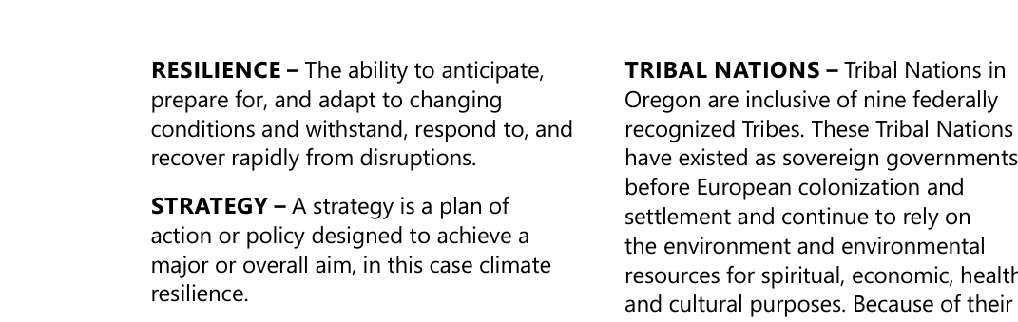
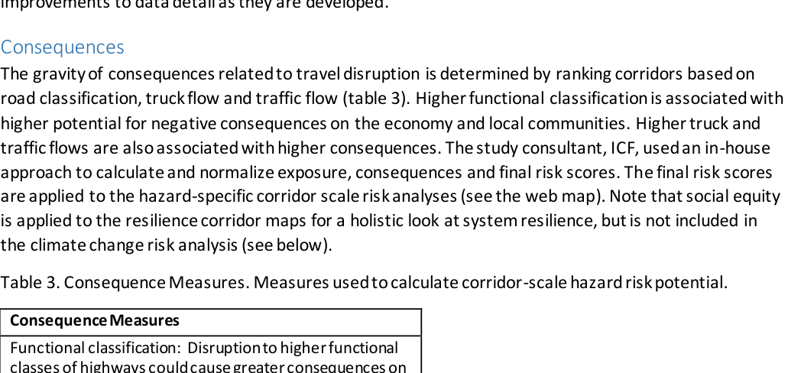
Oregon / ODOT: definition and risk scoring
15/20 | OR_ODOT_Climate_Adaptation_Resilience_Roadmap.pdf
Original excerpt: definition
Resilience definition - summary
RESILIENCE – The ability to anticipate, prepare for, and adapt to changing conditions and withstand, respond to, and recover rapidly from disruptions.
Source page: p. 10
Original excerpt: risk scoring / assessment
Risk scoring - summary
score/rating / ??????: ?????? consequence/severity/?????, exposure/????
Source page: p. 78
Source: OR_ODOT_Climate_Adaptation_Resilience_Roadmap.pdf; definition p.10, risk p.78; URL: https://www.tam-portal.com/wp-content/uploads/sites/12/2025/01/ClimateAdaptation_andResilienceRoadmap.pdf

Slide 20
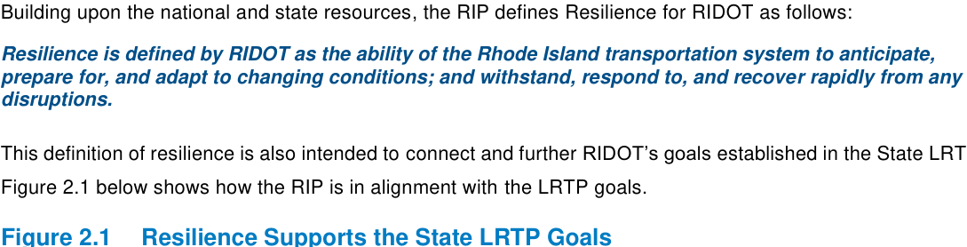
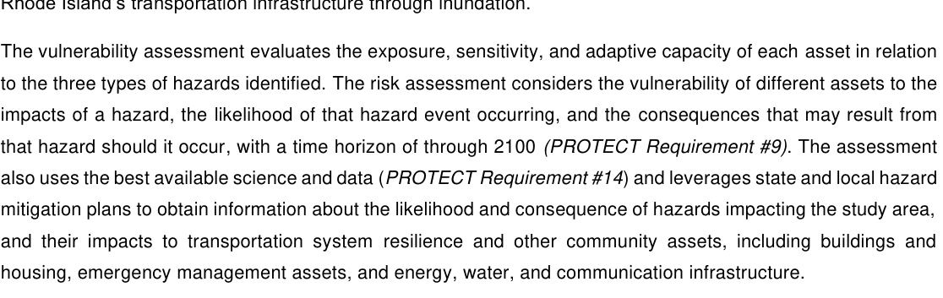
Rhode Island / RIDOT: definition and risk scoring
16/20 | RI_RIDOT_Approved_RIP.pdf
Original excerpt: definition
Resilience definition - summary
Resilience is defined by RIDOT as the ability of the Rhode Island transportation system to anticipate, prepare for, and adapt to changing conditions; and withstand, respond to, and recover rapidly from any disruptions.
Source page: p. 27
Original excerpt: risk scoring / assessment
Risk scoring - summary
risk-based assessment / ??????: ?????? exposure/???, sensitivity/???, adaptive capacity/????, vulnerability/????
Source page: p. 22
Source: RI_RIDOT_Approved_RIP.pdf; definition p.27, risk p.22; URL: https://www.dot.ri.gov/rhodeworks/docs/RIDOT_Approved_RIP.pdf

Slide 21
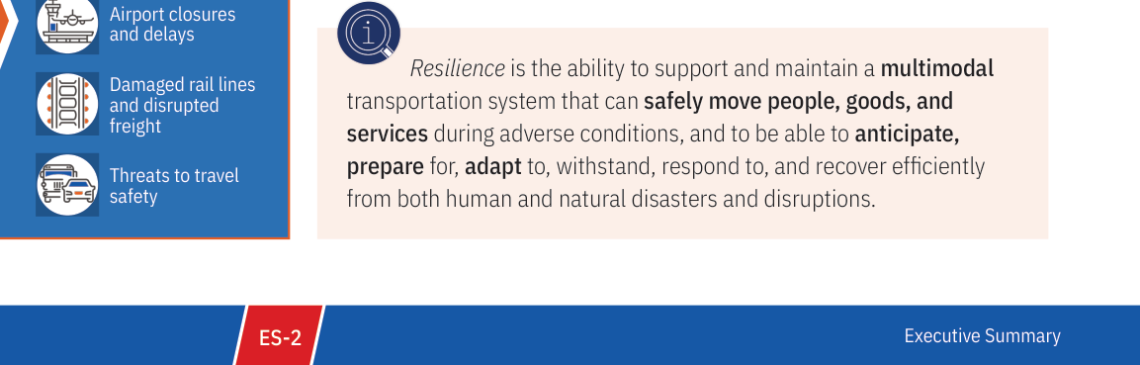
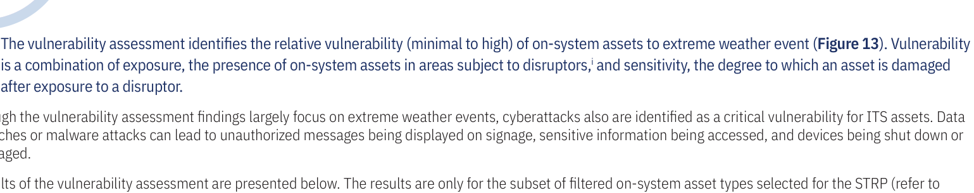
Texas / TxDOT: definition and risk scoring
17/20 | TX_TxDOT_Statewide_Transportation_Resilience_Plan_2025.pdf
Original excerpt: definition
Resilience definition - summary
Resilience is the ability to support and maintain a multimodal transportation system that can safely move people, goods, and services during adverse conditions, and to be able to anticipate, prepare for, adapt to, withstand, respond to, and recover efficiently from both human and natural disasters and disruptions.
Source page: p. 6
Original excerpt: risk scoring / assessment
Risk scoring - summary
risk-based assessment / ??????: ?????? exposure/???, sensitivity/???, vulnerability/????
Source page: p. 57
Source: TX_TxDOT_Statewide_Transportation_Resilience_Plan_2025.pdf; definition p.6, risk p.57; URL: https://www.txdot.gov/content/dam/docs/division/tpp/2025-statewide-resiliency-plan.pdf

Slide 22
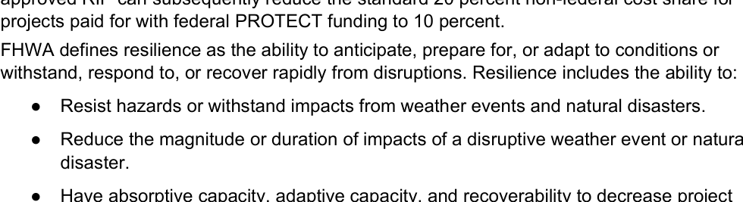
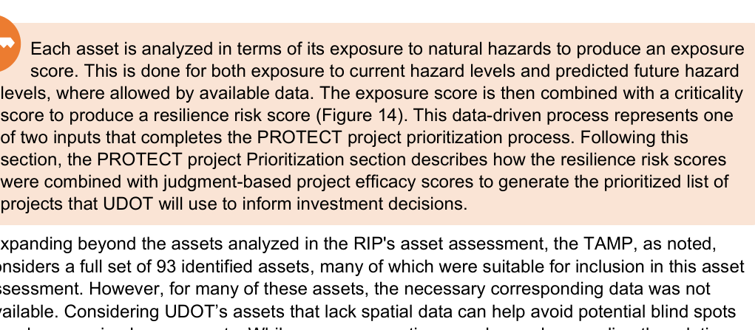
Utah / UDOT: definition and risk scoring
18/20 | UT_UDOT_Resilience_Improvement_Plan_2024.pdf
Original excerpt: definition
Resilience definition - summary
FHWA defines resilience as the ability to anticipate, prepare for, or adapt to conditions or withstand, respond to, or recover rapidly from disruptions.
Source page: p. 10
Original excerpt: risk scoring / assessment
Risk scoring - summary
score/rating / ??????: ?????? exposure/???, criticality/????
Source page: p. 38
Source: UT_UDOT_Resilience_Improvement_Plan_2024.pdf; definition p.10, risk p.38; URL: https://www.erm-portal.com/wp-content/uploads/sites/15/2024/09/2024-05-07-FINAL-UDOT-RIP-eee071ab388ba424f01311f4404fd110.pdf

Slide 23
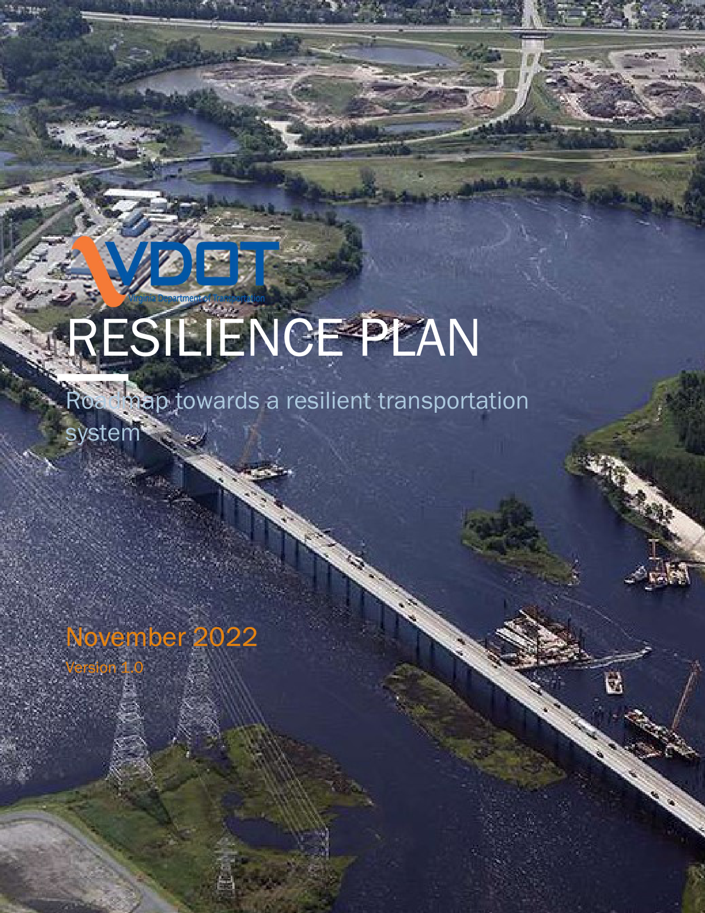
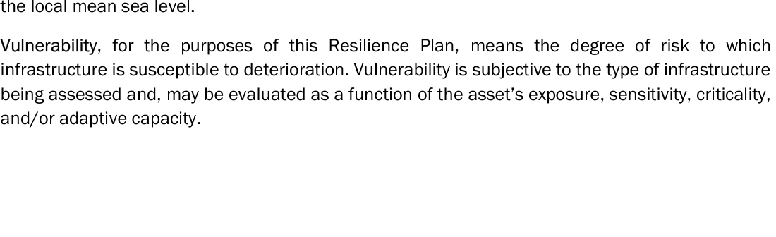
Virginia / VDOT: definition and risk scoring
19/20 | VA_VDOT_Resilience_Plan_2022.pdf
Original excerpt: definition
Resilience definition - summary
TABLE OF CONTENTS Resilience Plan Roadmap towards a resilient transportation system RESILIENCE PLAN November 2022 Version 1.0
Source page: p. 1
Original excerpt: risk scoring / assessment
Risk scoring - summary
risk-based assessment / ??????: ?????? exposure/???, sensitivity/???, adaptive capacity/????, criticality/???, vulnerability/????
Source page: p. 6
Source: VA_VDOT_Resilience_Plan_2022.pdf; definition p.1, risk p.6; URL: https://www.erm-portal.com/wp-content/uploads/sites/15/2023/03/VDOT-Resilience-Plan_Nov_2022_FINAL-92cd22fca3674bdb5af0a3eb49a7e62d.pdf

Slide 24
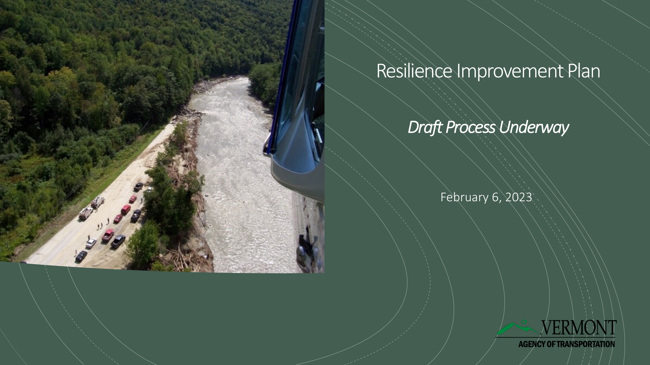
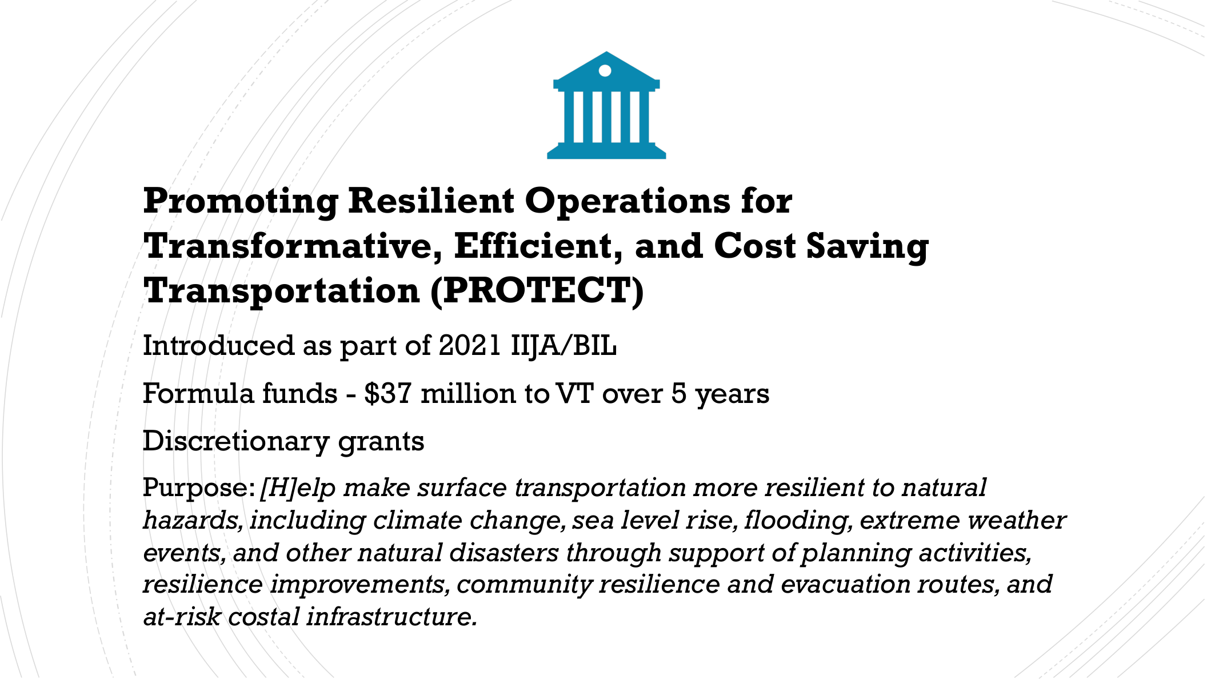
Vermont / VTrans: definition and risk scoring
20/20 | VT_VTrans_RIP_Process_2023.pdf
Original excerpt: definition
Resilience definition - summary
Resilience Improvement Plan Draft Process Underway February 6, 2023
Source page: p. 1
Original excerpt: risk scoring / assessment
Risk scoring - summary
?????????????????????/????????????????
Source page: p. 2
Source: VT_VTrans_RIP_Process_2023.pdf; definition p.1, risk p.2; URL: https://www.erm-portal.com/wp-content/uploads/sites/15/2023/03/2023-03-06-Vermont-RIP-Process-to-FHWA-VT-d6f8550d06fc4be24e33ab32ad4da7bd-1.pdf

Slide 25
Source Appendix
Downloaded PDFs used in this deck.
CA
CA_Caltrans_SCRIPT_RIP_2023_Amendment1.pdf
https://dot.ca.gov/-/media/dot-media/programs/transportation-planning/documents/office-of-smart-mobility-and-climate-change/2023-script
CO
CO_CDOT_Resilience_Improvement_Plan.pdf
https://www.tam-portal.com/wp-content/uploads/sites/12/2025/07/cdot-resilience-improvement-plan-final-02-10-2025.pdf
CT
CT_CTDOT_Resilience_Improvement_Plan.pdf
https://portal.ct.gov/dot/-/media/dot/programs/rip/ctdot-resilience-improvement-plan.pdf
DE
DE_DelDOT_DRIP_FHWA_Approved_2023.pdf
https://www.erm-portal.com/wp-content/uploads/sites/15/wpforms/7075-e1233af55e4247e91b2324b29a729bf8/DelDOT-DRIP-FHWA-Approved-09.07.23
FL
FL_FDOT_RIP_CEP_Final.pdf
https://fdotwww.blob.core.windows.net/sitefinity/docs/default-source/planning/resilience-(opp)/resilience-improvement-plan/rip_cep_fina
IA
IA_IowaDOT_2024_Resilience_Improvement_Plan.pdf
https://iowadot.gov/media/2596/download?inline=
KY
KY_KYTC_Resiliency_Improvement_Plan_2023.pdf
https://www.erm-portal.com/wp-content/uploads/sites/15/2024/08/KYTC-Resiliency-Improvement-Plan-202306-bfe355f2a24c9e7591e4146a5b7226e1
MD
MD_MDOT_Transportation_Resilience_Improvement_Plan_2024.pdf
https://www.mdot.maryland.gov/OPCP/MDOT_TRIP_Report_2024_Final.pdf
MI
MI_MDOT_Resilience_Improvement_Plan_2024.pdf
https://www.michigan.gov/mdot/-/media/Project/Websites/MDOT/Programs/Planning/Resilience-Improvement-Plan/Plan.pdf
MN
MN_MnDOT_Resilience_Improvement_Plan_2024.pdf
https://www.tam-portal.com/wp-content/uploads/sites/12/2025/07/2024-Resilience-Improvement-Plan-ADA-FINAL-38633998-v2.pdf
MS
MS_MDOT_Resilience_Improvement_Plan.pdf
https://mdot.ms.gov/documents/Planning/Resilience%20Planning/MDOT%20Resilience%20Improvement%20Plan.pdf
NC
NC_NCDOT_Resilience_Strategy_Report.pdf
https://www.ncdot.gov/initiatives-policies/Transportation/transportation-resilience/Documents/resilience-plan.pdf
NM
NM_NMDOT_Resilience_Improvement_Plan_2024.pdf
https://www.erm-portal.com/wp-content/uploads/sites/15/2024/08/2024_0324_NMDOT-RIP_Final-3e0d72b101139cc6da2af69c7c26a4d5.pdf
OH
OH_ODOT_Resilience_Improvement_Plan.pdf
https://dam.assets.ohio.gov/image/upload/transportation.ohio.gov/statewide-planning/resilience/Resilience-Improvement-Plan.pdf
OR
OR_ODOT_Climate_Adaptation_Resilience_Roadmap.pdf
https://www.tam-portal.com/wp-content/uploads/sites/12/2025/01/ClimateAdaptation_andResilienceRoadmap.pdf
RI
RI_RIDOT_Approved_RIP.pdf
https://www.dot.ri.gov/rhodeworks/docs/RIDOT_Approved_RIP.pdf
TX
TX_TxDOT_Statewide_Transportation_Resilience_Plan_2025.pdf
https://www.txdot.gov/content/dam/docs/division/tpp/2025-statewide-resiliency-plan.pdf
UT
UT_UDOT_Resilience_Improvement_Plan_2024.pdf
https://www.erm-portal.com/wp-content/uploads/sites/15/2024/09/2024-05-07-FINAL-UDOT-RIP-eee071ab388ba424f01311f4404fd110.pdf
VA
VA_VDOT_Resilience_Plan_2022.pdf
https://www.erm-portal.com/wp-content/uploads/sites/15/2023/03/VDOT-Resilience-Plan_Nov_2022_FINAL-92cd22fca3674bdb5af0a3eb49a7e62d.pdf

Slide 26
Source Appendix
Continued
VT
VT_VTrans_RIP_Process_2023.pdf
https://www.erm-portal.com/wp-content/uploads/sites/15/2023/03/2023-03-06-Vermont-RIP-Process-to-FHWA-VT-d6f8550d06fc4be24e33ab32ad4da7

